Slide 1
MFRE Summer Series: R Programming 1 Harry Izatt
2023/24 Summer Program

Slide 2
R Workshops Roadmap
R Workshop 1: Today
Working in basic R, general topics
1. Review data structures and manipulation
2. Best practices for R programming
R Workshop 2: Tomorrow
Dive into specific industry-standard data analysis library (Tidyverse)
3. Introduction to data cleaning: `dplyr`
4. Introduction to data visualization: `ggplot2`

Slide 3
R Workshop 1 Itinerary
1. Reviewing Basics
1.1 Data structures in R
1.2 Control Flow
2. Best practices for R programming
2.1 Indentation and line spacing
2.2 Naming variables and functions
2.3 Commenting code
2.4 Calling libraries, data import
2.5 Projects and `here()`
2.6 Headers in Markdown
2.7 Code cells

Slide 4
Introduction to R
What is R?
A programming language, with a paired development environment (Rstudio) designed for statistical computing and data analysis
What is it used for?
Data analysis and visualization
Statistics
Machine Learning
Research, particularly economics
Do we use it in MFRE?
YES
Main programming tool in MFRE data courses

Slide 5
R and Python
Substantial capability overlap
Data analysis, visualization, statistical modelling: doable in both
R
Stronger academic focus, with advanced econometric packages for causal models
Specifically designed by statisticians, for doing statistics
Python
General-purpose language with very wide capability
More industry focus, broader range of user-defined packages
Particularly for Machine Learning, Artificial Intelligence
BOTH are useful, and learning both strengthens overall skills

Slide 6
R Workshop 1 Case (1/3)
It’s been a few years since you left university. Life is good. You’ve happily settled into consulting work; you mostly just make PowerPoint presentations look nice, and dig into a thesaurus for fancy words to wow the clients.
You steer clear of more “math-ey” work, and when it’s unavoidable, you hack something together in Excel.
But then your boss sends you an email, with dire news:

Slide 7
R Workshop 1 Case (2/3)
Hey John/Jane,
We’ve gotten a new request from some industry clients for some data analysis. All inflation is high at the moment, but apparently food has been racing way ahead of everything else for the last year. Or something, I dunno. I’m more of an “ideas” guy, not really a data person. Your last task is basically wrapped up, so I thought I’d give you your first independent project.
You’re not our most technical person, but that’s no problem – you mentioned you were a real expert on R back at university, right? I’ve attached the data with this email.
- Sincerely,
Bertrand Oscar Scott-Stewart
P.S. The data’s a real mess and needs work. Shouldn’t be a problem! Send me your starting visualizations by tomorrow evening.

Slide 8
R Workshop 1 Case (3/3)
You begin to regret that line saying “R Language Programming: Advanced Proficiency” on your resume
You may have exaggerated just a little bit to get this job
Now it’s time to make up lost ground – and fast!

Slide 9
Section 1
Review of Basics

Slide 10
1.1 Data Structures in R
Because R is meant for statistical programming, we’re going to start with the characteristics of the main data types used in variables
These can be divided in two:
1. Simple data types
Individual values
E.g.
my_number <- 5
my_char <- “a”
2. Compound data types
Contain multiple values within
E.g.
my_vector <- c(1, 2, 3, 4, 5)
NOTE: Text contained in `` markers is to read as code
Common approach in Markdown documents, and used to denote code chunks themselves!

Slide 11
1.1 Simple Data Types
1. Numeric
Represent real and decimal numbers
E.g.
100
3.14
2. Integer
Represent whole numbers without decimal points
Add “L” suffix to specify Integer rather than non-decimal Numeric
E.g.
13L
2023L
3. Character
Represent textual data; enclosed with quotes (‘single’ or “double”)
E.g.
‘Happiness’
“Misery”
4. Logical
Represent “Boolean” values (TRUE or FALSE) indicating logical conditions
Less used for storing data; more for control flow and conditions
E.g.
TRUE
FALSE

Slide 12
1.1 Compound Data Types
5. Vector
A collection of elements of one type
E.g.
c(1, 2, 3, 4, 5
c(“a”, “b”, “c”)
6. Matrix
A 2D collection with rows and columns
Created with `matrix()` function
E.g.
matrix(1:6, nrow=2, ncol=3)
matrix(c(1,2,3,4,5,6), nrow=2, ncol=3)
7. Array
Extension of Matrix concept into N-dimensions
E.g.
array(1:18, dim = c(3, 3, 2))
array(1:6, dim = c(2, 3))
8. DataFrame
A table of data values with named columns and rows; like Excel sheets
Will use similar-but-improved, “tibble” data type instead with Tidyverse
E.g.
data.frame(name = c(“Alice”, “Bob”), age = c(25, 30))

Slide 13
1.1 R/Python Equivalents and Near-Equivalents
R Data Structure | Python Equivalent | Similarities | Differences
Numeric | Float64 | Numeric, possibly decimal-point data | R Numeric includes non-decimal data; this is always Int64 in Python
Integer | Int64 | Integer data | R Ints specified with L suffix; not required in Python
Character | String | Textual data enclosed within quotation marks
Logical | Boolean | Logical expressions | R TRUE/FALSE in full-caps; Python True/False
Vector | List | Collections of multiple elements | R Vectors hold only one type; Python Lists can hold variety of data

Slide 14
1.1 R/Python Equivalents and Near-Equivalents
R Data Structure | Python Equivalent | Similarities | Differences
Vector | List | Collections of multiple elements | R Vectors hold only one type; Python Lists can hold variety of data
Matrix | Matrix (`numpy` package) | 2-Dimensional collection of numeric or string data points | Matrix not native to Python, used in `numpy` package for efficient computing
Array | Array (`numpy` package) | N-Dimensional collection of numeric or string data points | Array not native to Python as with Matrix; imported for similar use through `numpy`
Data Frame | DataFrame (`pandas` package) | Tabular format holding data in named columns | Pandas DataFrame used in actual work more, while R Data Frame superseded by `tibble` in hands-on work

Slide 15
1.2 Control Flow in R
Storing data is all well and good, but we want to do things with it
Chief advantage of computers over people: computers excel at repetitive, clearly-defined actions
Control Flow is how we establish what to do, in what order, and how to do it
Chief methods
1. Conditional statements
Provide condition and action to complete if it’s TRUE, action to complete if FALSE
Can have many structures, including “if not condition_a but condition_b”, and instructions for if no conditions are met
2. Loops
Instructions to repeat as long as some condition met
“For” loops: repeat a specified number of times
“while” loops: repeat an ambiguous number of times

Slide 16
1.2 Control Flow in R
Chief methods (cont)
3. Functions
Assign specific instructions to one object, which can be called repeatedly (with altered inputs) to perform similar processes cleanly
Technically, anything that can be done with a function can also be done without, but in a worse and painful manner

Slide 17
Section 1
Heading to Rstudio!

Slide 18
Section 2
Best Practices for R Programming

Slide 19
2. Best Practices for R Programming
Just because code runs, and even gets the desired output, doesn’t mean it’s good!
What is bad code?
Unclear
Hard to tell what it’s doing
Hard to tell why it’s making each step
Complex
Unnecessary pieces
Calls of DataFrames (to check column names) left in
Inefficient (probably not major concern yet)
Avoid running loops over full dataframes; use specific functions meant for it
Setting redundant functions

Slide 20
2. Best Practices for R Programming
Clarity is our major focus
Even when you’re working “alone” you’re still collaborating with your future self
Gap between writing code and reading it again -> you forget about how it works, why you wrote it a certain way, etc
Even worse for others reading your code, who never planned/wrote it!
How?
Correct indentation, line spacing
Descriptive variable, function names
Commenting code
Also:
Other techniques that make your code easier to work with, for you and others

Slide 21
Section 2
Heading to Rstudio!
(not primarily code, but best shown with code)

Slide 22
Conclusion

Slide 23
What we learned
Basic R data types
Control flow
How to write legible code
Why we comment our code
How to structure R Markdown documents

Slide 24
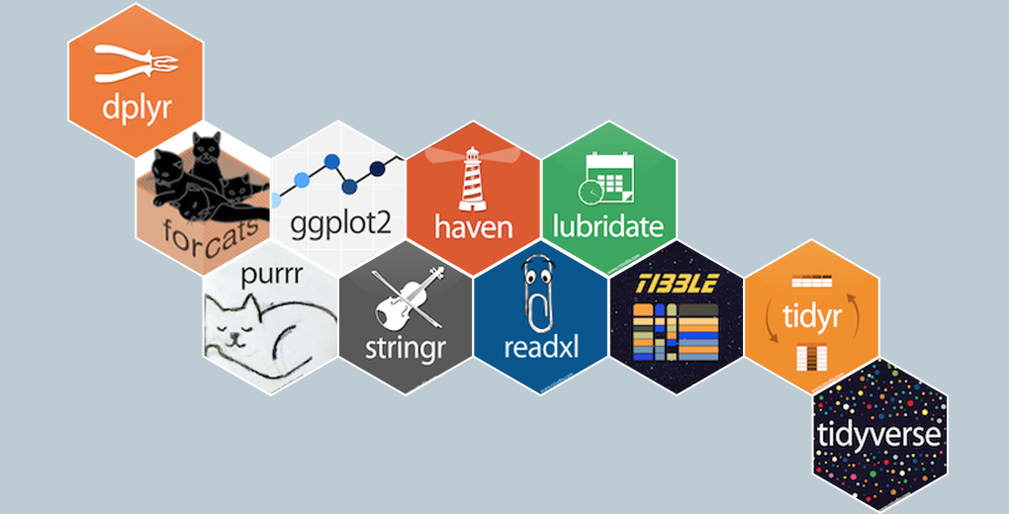
Next Workshop:
Working with Tidyverse
dplyr
Core functions for data cleaning
ggplot2
Line plots
Scatter plots
Regression plots

Slide 25
Thanks for coming!
2023/24 Summer Program

